Slide 1
GE8151 Problem Solving and Python Programming
Rajasekaran S
Assistant Professor,
Department of Information Technology,
KGiSL Institute of Technology,
email: proffraja@gmail.com
Github:www.github.com/rajasekaranap

Slide 2
Building Blocks of Algorithm
Statements/Instructions
Variables
Sequence
Conditionals
State
Repetition/Control Flow Structures
Functions/Sub Programs

Slide 3
Instructions/Statements
It is heart and sole for algorithms.
It is a smallest stand alone entity.
For example
C = A + B [a statement performs addition]
We cannot divide more into simple elements.
All algorithms eventually broken into statements.

Slide 4
Sequence
It means that steps of an algorithm are carried out in sequential manner, where each step must be executed exactly once.
Proper ordering of statements lead us to desired results.
Eg:
Step1: Read A and B
Step2: Perform C = A + B;
Step3: Print C

Slide 5
Variables
It is place to store the temporary values while algorithm is executing.
It helps to algorithm function correctly and effectively.
Variables values can vary as the algorithm progress.
Eg:
Step1: Assign A with value 10
Step2: Assign B with value 20
Step3: Compute A + B and store in A
Print A

Slide 6
State
While executing an algorithm the machine transits over different states.
a program is described as stateful if it is designed to remember preceding events or user interactions; the remembered information is called the state of the system.

Slide 7
State
Start
S
State 1
S
State 2
S
Final
State
F
F

Slide 8
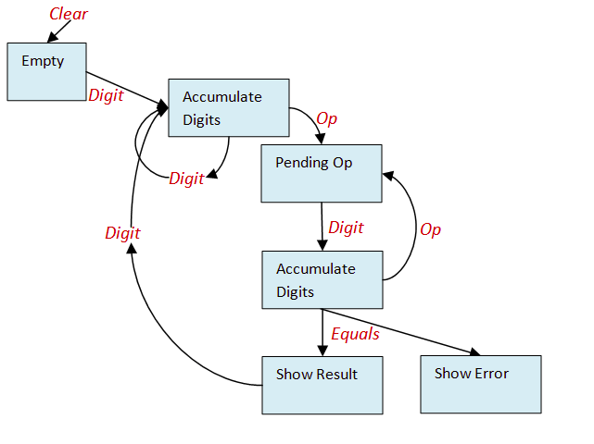
Sate of a calculator

Slide 9
Conditionals
It is a statement that used to make decisions.
Conditional execution contains if-else statement and condition that gives true or false while evaluating.
Based on the condition a particular branch of statement will be executed.

Slide 10
Control Flow
It is also known as flow control.
It is used to decide to run a block of statements
One Time
N Times
Zero Time
based on valuation of some conditions.

Slide 11
Types of Control Flow Statements
Unconditional Branch or Jump
Conditional Branch
Looping
Subroutines [Functions]
Stop or halt the program execution.

Slide 12
Functions
It is also known as sub set of an algorithm or block of instructions.
It can be called when ever needed.
It gives the reusability of instructions set and reduces the size of an algorithms.

Slide 13
Thank You
Rajasekaran S
Assistant Professor,
Department of Information Technology,
KGiSL Institute of Technology,
email: proffraja@gmail.com
Github:www.github.com/rajasekaranap

